Slide 1
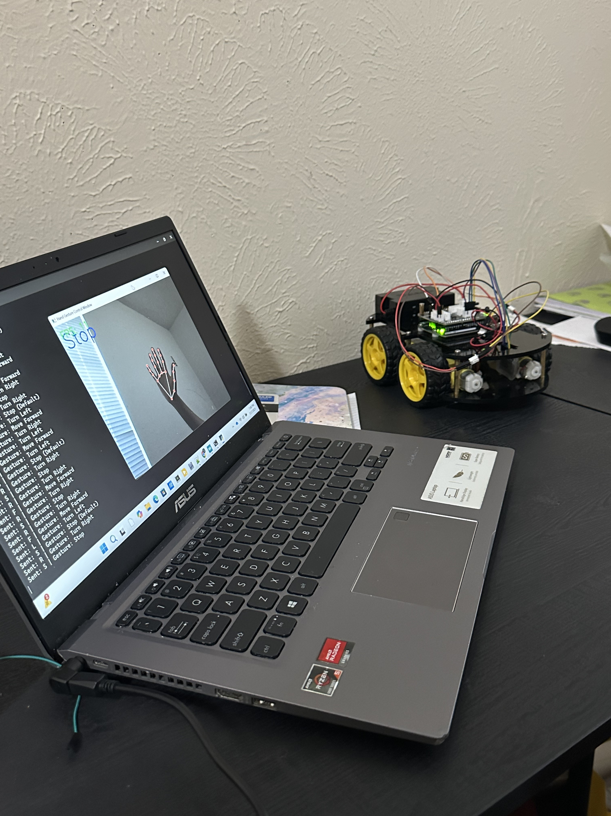
Hand Gesture Controlled Robot Car Project

Slide 2
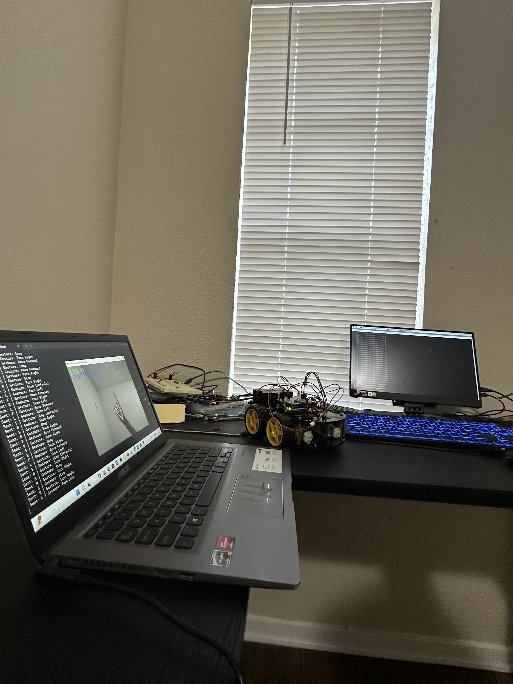
Overview
This project focuses on building a gesture-controlled robot car by integrating computer vision, embedded hardware, and wireless communication. Hand gestures are detected in real-time using MediaPipe running on a PC. These gestures are then converted into specific movement commands and sent to a Flask server hosted on a Raspberry Pi. The Raspberry Pi forwards the commands via Bluetooth to an Arduino, which drives the motors of the robot. Due to a hardware limitation in the L298N motor driver, only two motor channels are functional, so all four motors are wired in pairs. As a result, the robot supports forward and backward motion, while left and right gestures are still processed to verify the end-to-end signal flow. This project demonstrates how different technologies can work together to create an interactive and responsive robotic system.

Slide 3
Tools Used (Hardware)
Arduino Uno (microcontroller board)
Motor driver module (to control car motors)
DC motors and wheels
USB/Bluetooth module (for communication and power)
Webcam or laptop camera
Raspberry Pi

Slide 4
Tools Used (Software)
Python programming language
MediaPipe library (for hand detection)
OpenCV library (for image processing)
Arduino IDE (to program the Arduino board)
Serial communication (to send commands from PC to Arduino)

Slide 5
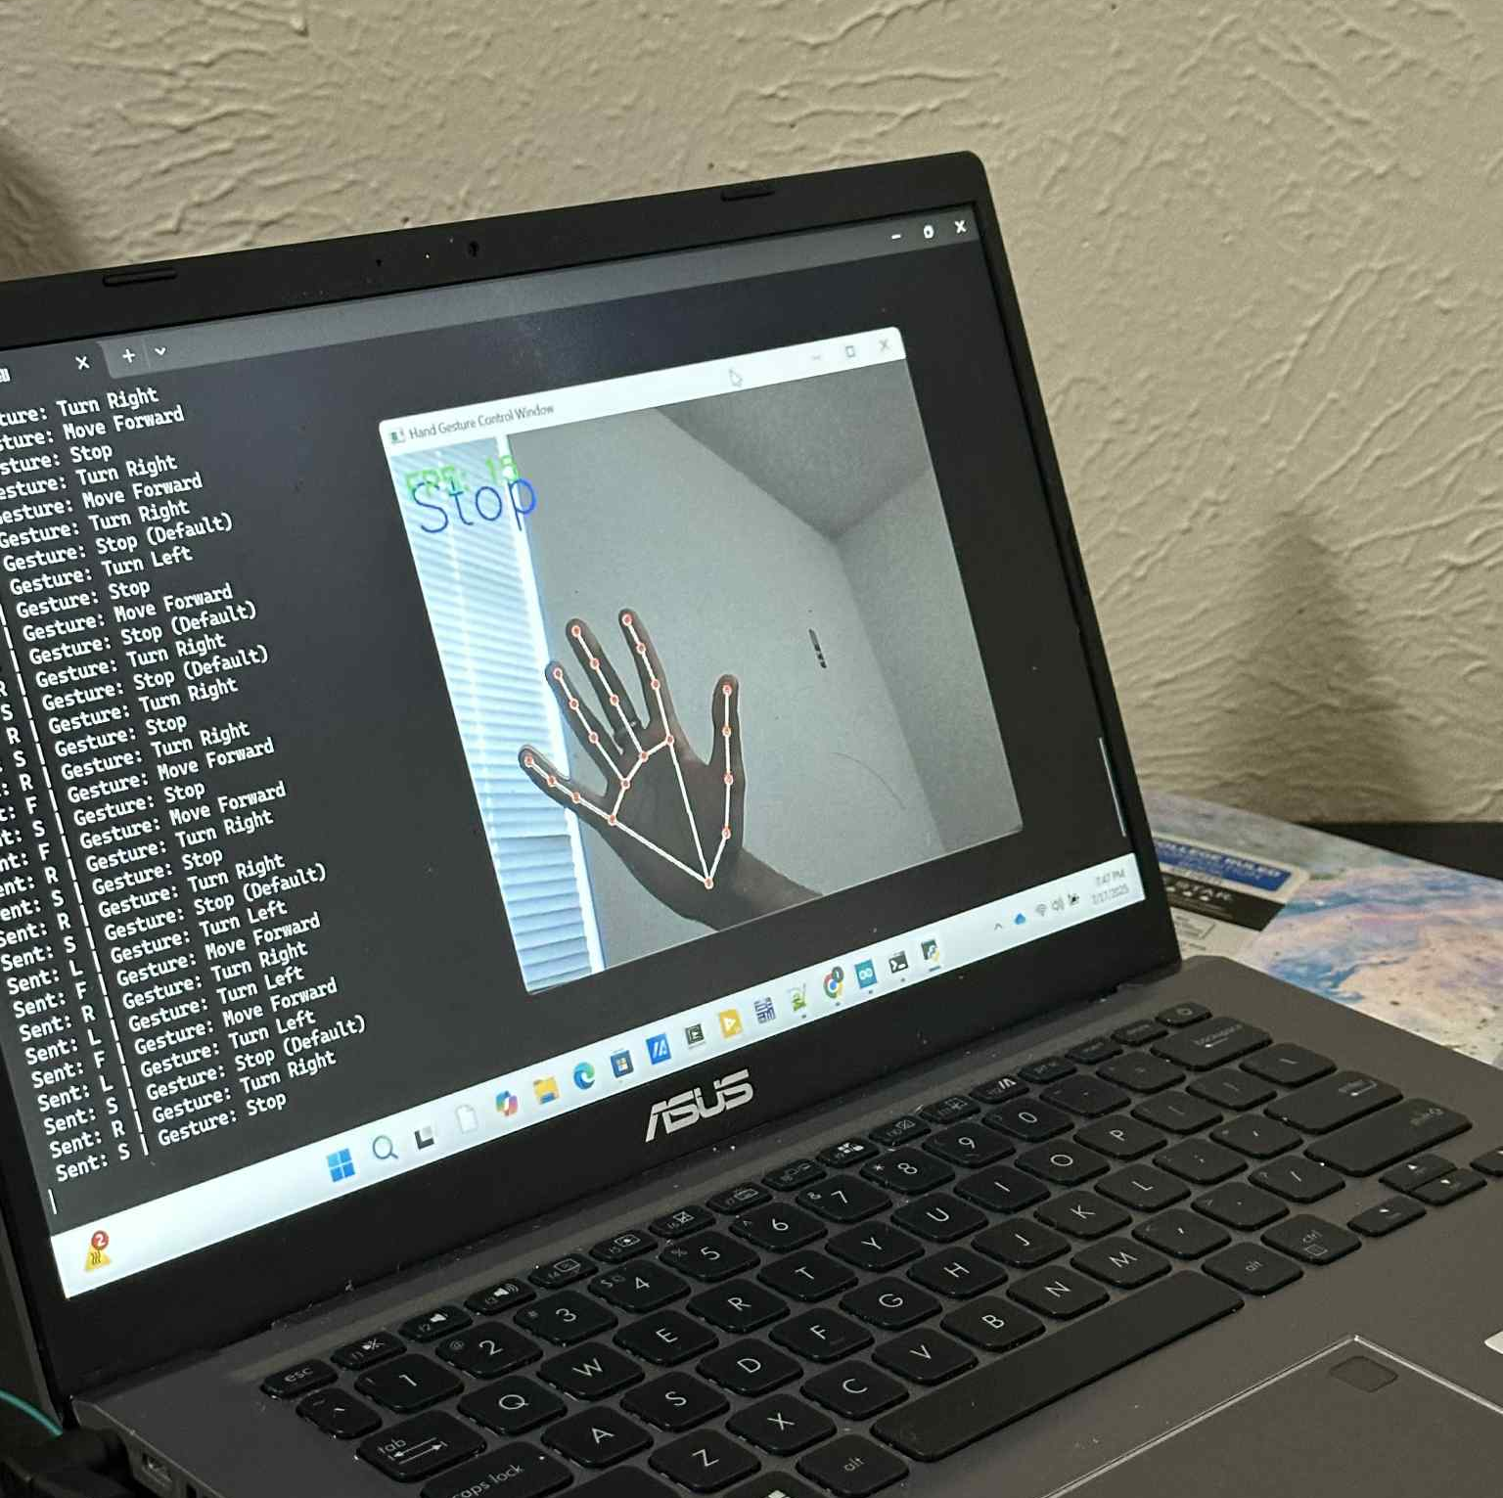
Inside PC
The PC is responsible for capturing and interpreting hand gestures using a webcam and MediaPipe, a machine learning framework for real-time computer vision. When a specific gesture is recognized — such as moving the hand forward, backward, left, or right — it is mapped to a corresponding command like 'F', 'B', 'L', 'R', or 'S'. Once the gesture is detected, the PC sends this command as a JSON POST request to the Raspberry Pi’s Flask server over the local network.

Slide 6
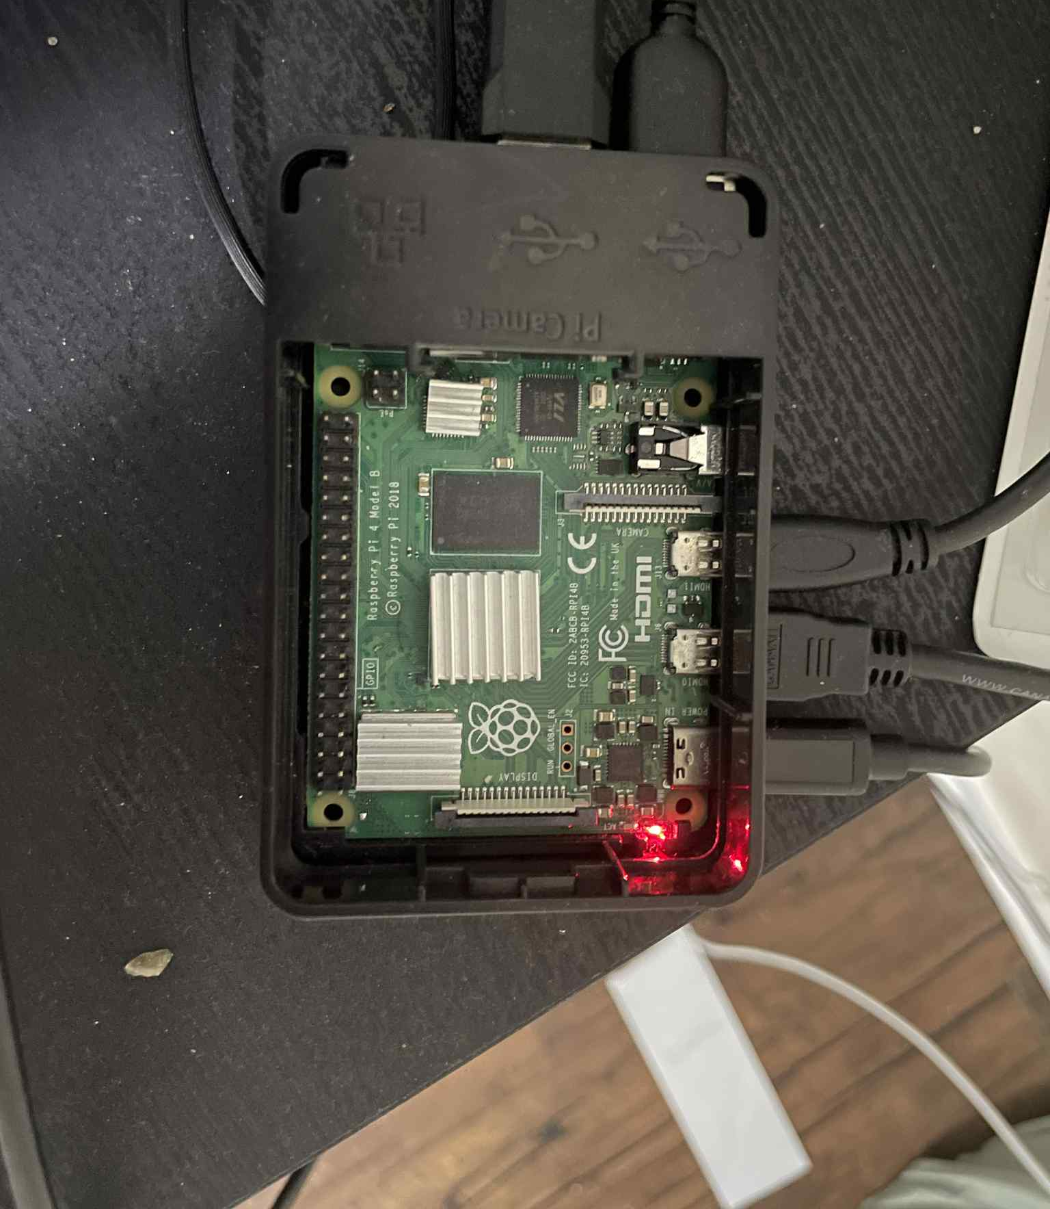
Raspberry Pi (Flask Server + Bluetooth Communication)
The Raspberry Pi runs a lightweight Flask server that listens for incoming HTTP POST requests from the PC. Each request contains a gesture command. When a command is received, the Raspberry Pi writes this command to the serial port connected to the HC-05 Bluetooth module (e.g., /dev/rfcomm0). This effectively sends the command wirelessly to the Arduino. The Pi acts as a communication bridge, translating network-based commands into Bluetooth serial signals.

Slide 7

Arduino (Motor Control)
The Arduino receives the gesture command via Bluetooth using the HC-05 module connected to its hardware serial pins (0 and 1). Once the command is received, the Arduino interprets it and controls the motor driver accordingly. The motor driver used in this project (L298N) has only two working channels, so all four motors are wired in pairs. Based on the command received ('F', 'B', 'L', 'R', or 'S'), the Arduino sets the appropriate direction and speed for the motors. Only forward and backward motions are executed physically, while left and right commands are still processed to validate the communication and gesture logic.

Slide 8
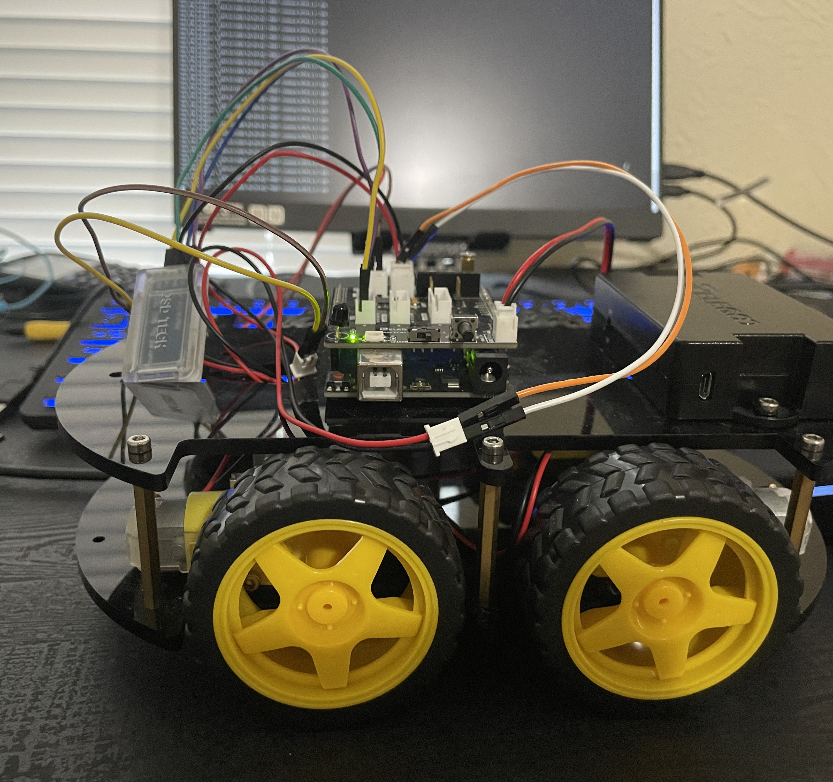
Summary
The PC uses MediaPipe to detect hand gestures in real time and sends gesture commands to a Flask server on the Raspberry Pi. The Raspberry Pi receives these commands and forwards them via Bluetooth using the HC-05 module to the Arduino. The Arduino reads the commands and drives the motors based on the received signal. The motor driver supports only two working channels, so the robot performs forward and backward movement, while left and right commands are used to verify communication. The blinking pattern of the HC-05 module indicates whether Bluetooth is connected or not, helping during debugging and testing.

Slide 9
That’s It!!
Thank You.

